Slide 1
ML Project
On Covid Data

Slide 2
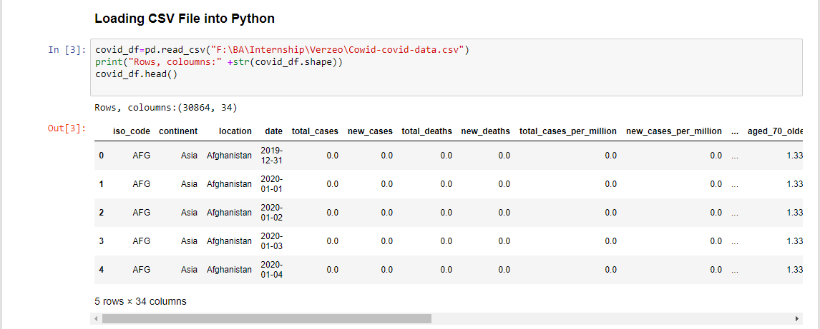
Importing Data into Python
Our source for this project is: https://covid.ourworldindata.org/data/owid-covid-data.csv
The data frame contains 30864 Rows and 34 columns

Slide 3
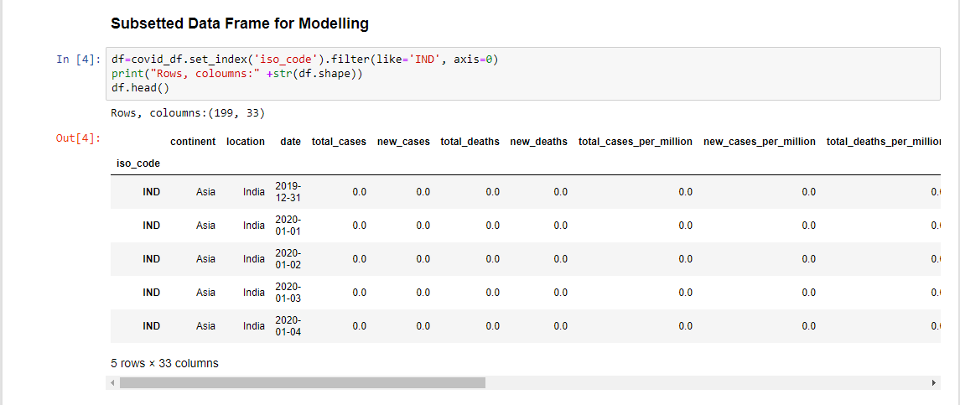
Sub setting column for Modelling
Our project required Subset with only those rows that have “India” in the “location” column
The data frame contains 199 Rows and 33 columns

Slide 4
Bivariate Analysis

Slide 5
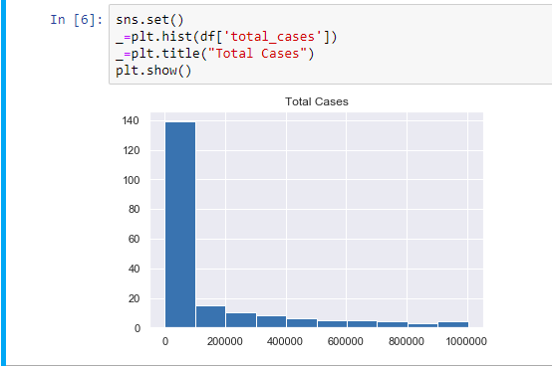
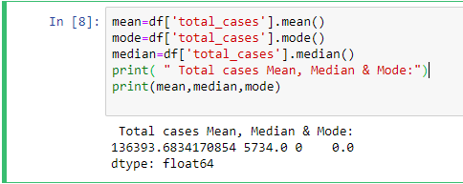
Total cases
Conclusion:
Mean, Median & Mode
Interference
The total no of cases drastically increases at higher rate.
HISTOGRAM

Slide 6
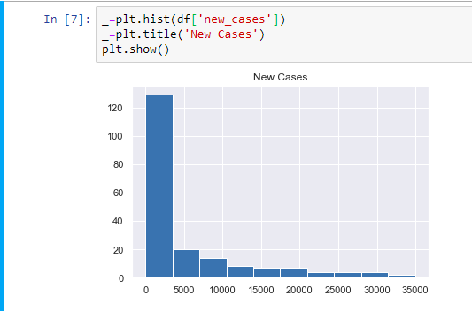
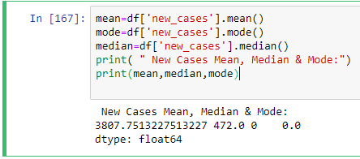
New Cases
Conclusion:
Mean, Median & Mode
Interference
The total no of new cases drastically increases at higher rate.
HISTOGRAM

Slide 7
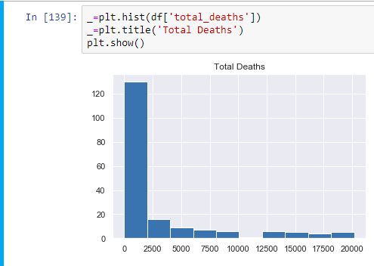
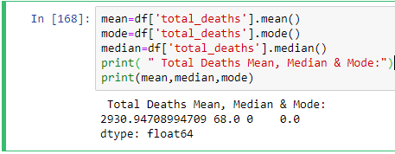
Total Deaths
Conclusion:
Mean, Median & Mode
Interference
The total no of death drastically increases as the vaccine is yet not came in market .
HISTOGRAM

Slide 8
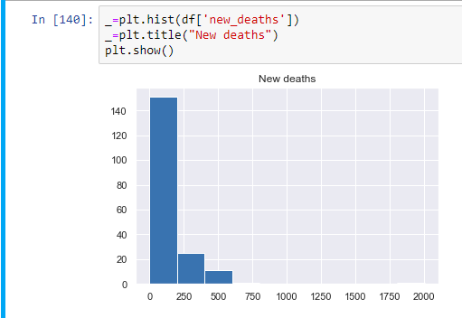
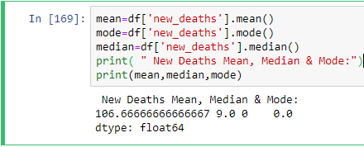
New Deaths
Conclusion:
Mean, Median & Mode
Interference
The total no of new death increases at higher rate.
HISTOGRAM

Slide 9
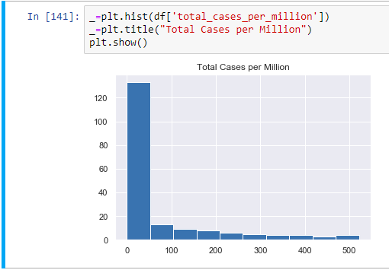
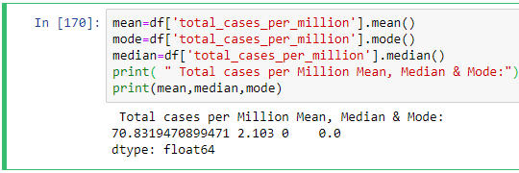
Total cases per million
Conclusion:
HISTOGRAM
Mean, Median & Mode

Slide 10
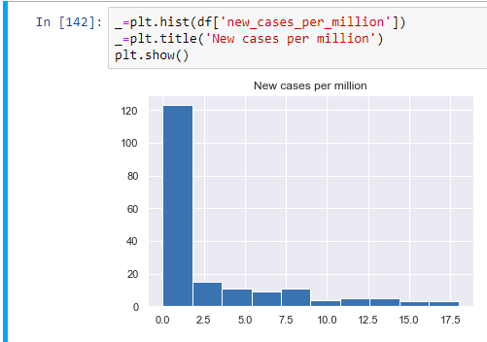
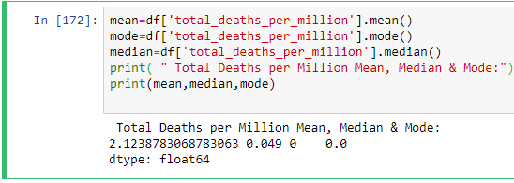
New Cases per Million
Conclusion:
Mean, Median & Mode
Interference
There is a higher no of new cases as compared to the past .
HISTOGRAM

Slide 11
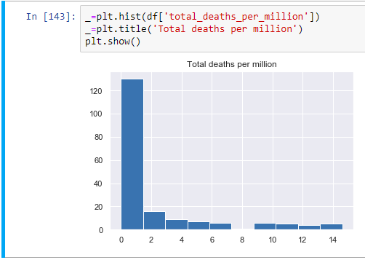
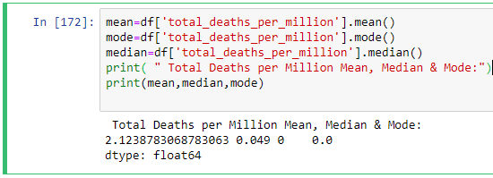
Total Deaths per million
Conclusion:
Mean, Median & Mode
Interference
There is a higher no of death in recent date .
HISTOGRAM

Slide 12
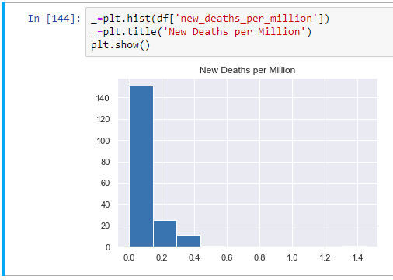
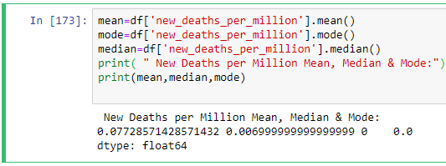
New Deaths per million
Conclusion:
HISTOGRAM
Mean, Median & Mode

Slide 13
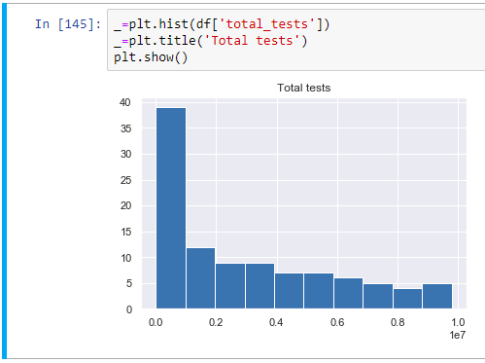
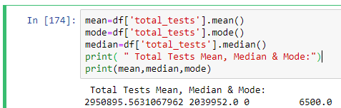
Total tests
Conclusion:
Mean, Median & Mode
Interference
The total no of test is increased with respect to past .
HISTOGRAM

Slide 14
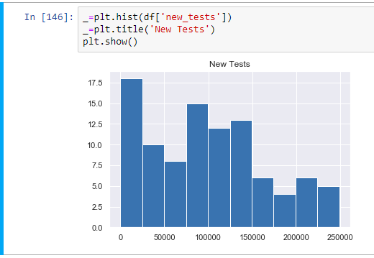
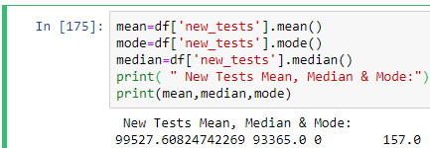
New tests
Conclusion:
HISTOGRAM
Mean, Median & Mode

Slide 15
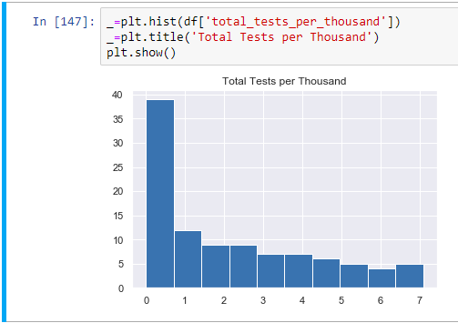
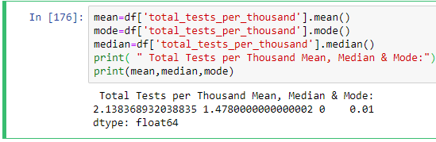
Total tests per thousand
Conclusion:
Mean, Median & Mode
Interference
Total no of testing per thousand is increased .
HISTOGRAM

Slide 16
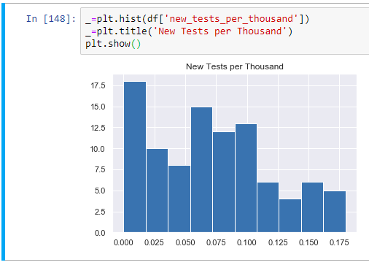
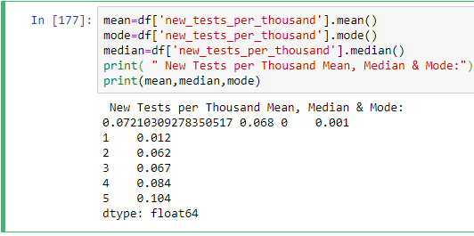
New tests per thousand
Conclusion:
HISTOGRAM
Mean, Median & Mode

Slide 17
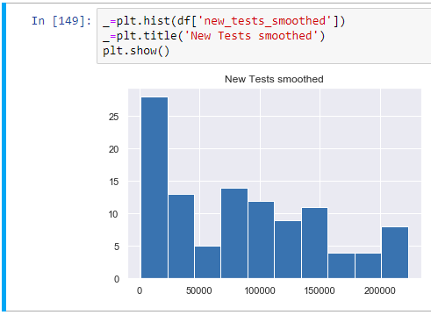
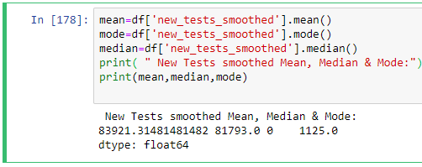
New tests smoothed
Conclusion:
HISTOGRAM
Mean, Median & Mode

Slide 18
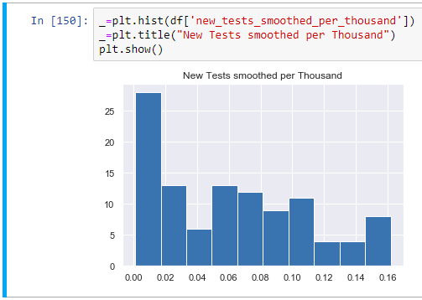
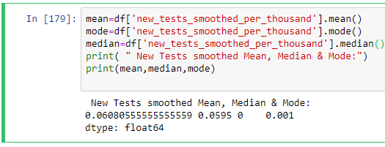
New tests smoothed per thousand
Conclusion:
HISTOGRAM
Mean, Median & Mode

Slide 19
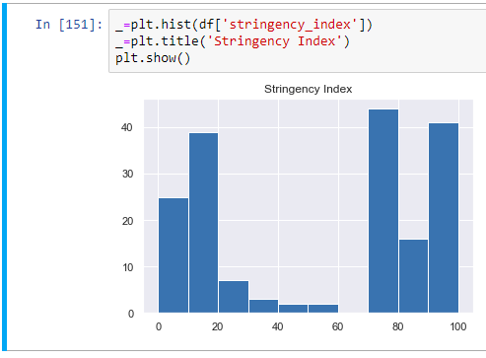
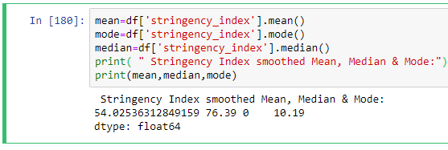
Stringency index
Conclusion:
Mean, Median & Mode
Interference
This show the strictness which 'lockdown style' policies that primarily restrict people's behaviour.
HISTOGRAM

Slide 20
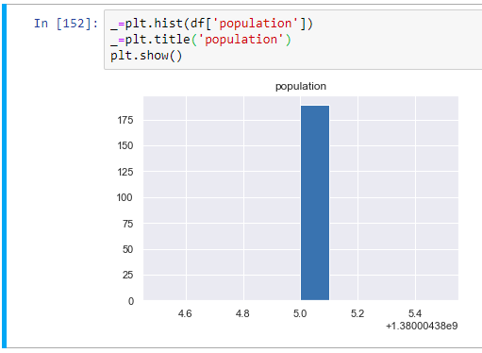
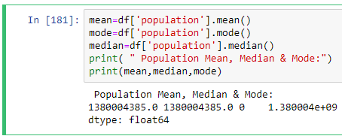
population
Conclusion:
HISTOGRAM
Mean, Median & Mode

Slide 21
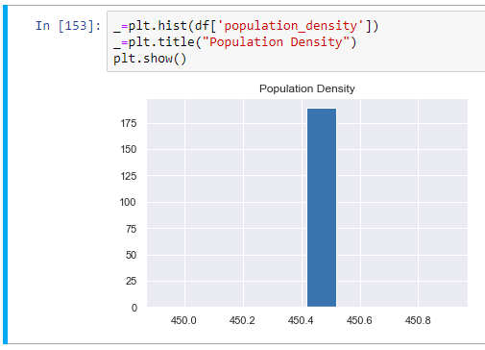
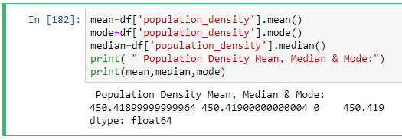
Population Density
Conclusion:
HISTOGRAM
Mean, Median & Mode

Slide 22
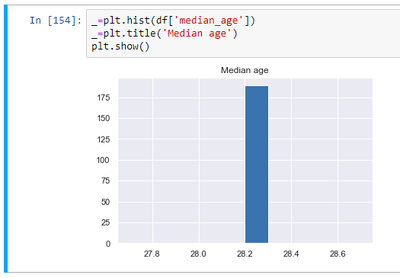
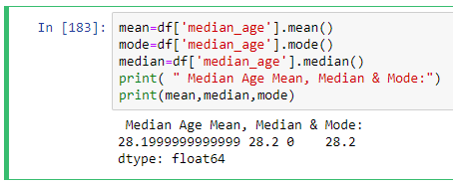
Median age
Conclusion:
HISTOGRAM
Mean, Median & Mode

Slide 23
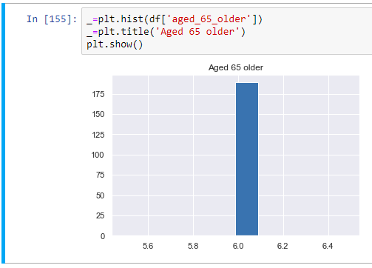
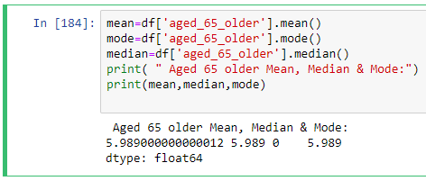
Aged 65 older
Conclusion:
HISTOGRAM
Mean, Median & Mode

Slide 24
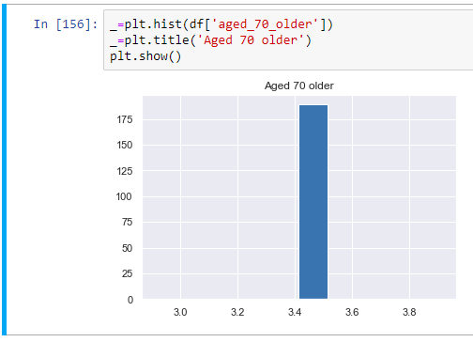
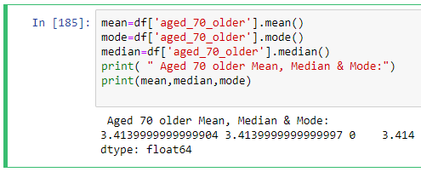
Aged 70 older
Conclusion:
HISTOGRAM
Mean, Median & Mode

Slide 25

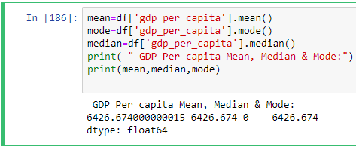
Gdp per capita
Conclusion:
HISTOGRAM
Mean, Median & Mode

Slide 26
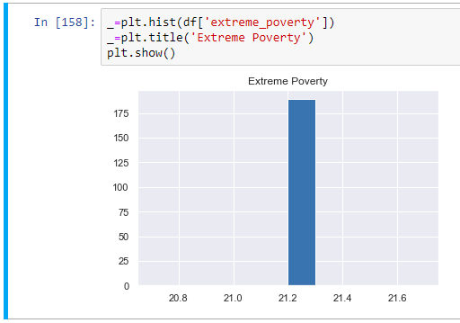
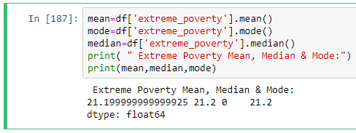
Extreme poverty
Conclusion:
HISTOGRAM
Mean, Median & Mode

Slide 27
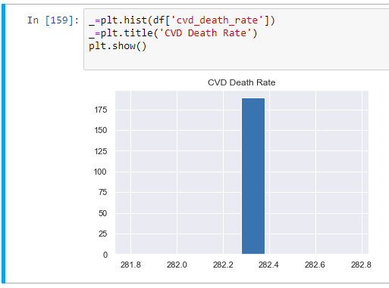
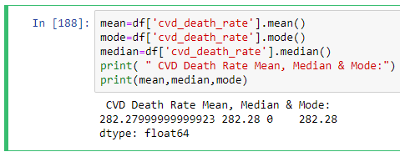
Cvd death rate
Conclusion:
HISTOGRAM
Mean, Median & Mode

Slide 28

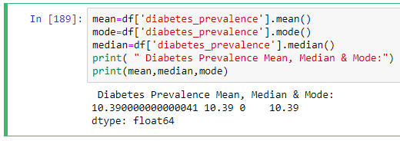
Diabetes prevalence
Conclusion:
HISTOGRAM
Mean, Median & Mode

Slide 29
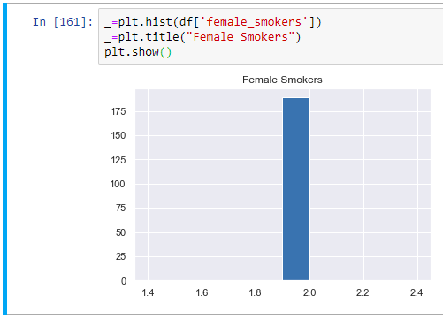
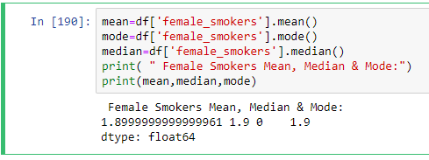
Female smokers
Conclusion:
HISTOGRAM
Mean, Median & Mode

Slide 30


Male smokers
Conclusion:
HISTOGRAM
Mean, Median & Mode

Slide 31


Handwashing facilities
Conclusion:
HISTOGRAM
Mean, Median & Mode

Slide 32


Hospital beds per thousand
Conclusion:
HISTOGRAM
Mean, Median & Mode

Slide 33


Life expectancy
Conclusion:
HISTOGRAM
Mean, Median & Mode

Slide 34

TOTAL CASES VS NEW CASES

Slide 35

TOTAL CASES VS TOTAL DEATHS

Slide 36

TOTAL CASES VS NEW DEATHS

Slide 37

TOTAL CASES VS TOTAL CASES PER MILLION

Slide 38

TOTAL CASES VS NEW CASES PER MILLION

Slide 39

TOTAL CASES VS NEW DEATHS PER MILLION

Slide 40

TOTAL CASES VS TOTAL TESTS

Slide 41

TOTAL CASES VS NEW TESTS

Slide 42

TOTAL CASES VS TOTAL TESTS PER THOUSAND

Slide 43

TOTAL TESTS VS NEW TEST PER THOUSAND

Slide 44

TOTAL CASES VS NEW TESTS SMOOTHED

Slide 45

TOTAL CASES VS NEW TESTS SMOOTHED PER THOUSAND

Slide 46

TOTAL CASES VS STRINGENCY INDEX

Slide 47

TOTAl cases vs populatIon

Slide 48

POPULATION DENSITY

Slide 49

TOTAL CASES VS MEDIAN AGE

Slide 50

TOTAL CASES VS AGED 65 YEARS OLDER

Slide 51

TOTAL CASES VS AGED 70 OLDER

Slide 52

TOTAL CASES VS GDP PER CAPITA

Slide 53

TOTAL CASES VS EXTREME POVERTY

Slide 54

TOTAL CASES VS CVD DEATH RATE

Slide 55

TOTAL CASES VS DIABETES PREVALENCE

Slide 56

TOTAL CASES VS FEMALE SMOKERS

Slide 57

TOTAL CASES VS MALE SMOKERS

Slide 58

TOTAL CASES VS HANDWASHING FACILITIES

Slide 59

TOTAL CASES VS HOSPITAL BEDS PER THOUSANDS

Slide 60

TOTAL CASES VS LIFE EXCPENTANCY

Slide 61
Line plots

Slide 62


Total Cases Vs New cases
Interference
The increase in no of new cases leads to an increase in total cases

Slide 63


Total Cases Vs Total Deaths
Interference
As the total cases will increase the total no of death also increases.

Slide 64


Total Cases Vs New Deaths

Slide 65


Total Cases Vs Total Cases per Million
Interference
There is a positive correlation between total cases and total cases per million

Slide 66


Total Cases Vs New Total Cases per Million
Interference
As the no of test increases the no of new cases got increase

Slide 67


Total Cases Vs New Deaths per Million
Interference:
It indicate that at certain period during pandemic there is a hike of total no of death as the awareness of precautionary measure was very low

Slide 68


Total Cases Vs Total Tests
Interference:
The more the no of people get tested the no of total cases got increased

Slide 69


Total Cases Vs New Tests
Interference:
As the no. of total Tests increases the Total no of Cases increases

Slide 70


Total Cases Vs Total tests per thousands
Interference :
As the total tests per thousand rises the total cases rises.

Slide 71


Total Cases Vs New tests per thousands
Interference
As the total no of test increases the total no of cases also increases

Slide 72


Total Cases Vs New Test smoothed

Slide 73


Total Cases Vs New Test smoothed per thousand

Slide 74


Total Cases Vs Stringency Index
Interference
As the strictness increase by Police the total no of cases become constant.

Slide 75


Total Cases Vs Population

Slide 76


Total Cases Vs Population Density
Interference
On the same population density the cases rises with time.

Slide 77


Total Cases Vs Median Age

Slide 78


Total Cases Vs Aged 65 years older
Interference
The total no of cases of aged 65 year remain same as the total no of cases increases.

Slide 79


Total Cases Vs Aged 70 years older

Slide 80


Total Cases Vs GDP per Capita

Slide 81


Total Cases Vs Extreme Poverty

Slide 82


Total Cases Vs CVD Death Rate

Slide 83


Total Cases Vs Diabetes Prevalence

Slide 84


Total Cases Vs Female Smokers

Slide 85


Total Cases Vs Male Smokers

Slide 86


Total Cases Vs Handwashing Facilities

Slide 87


Total Cases Vs Hospital Beds per Thousands
Interference
The total no of beds remain same but the total no of cases increases

Slide 88


Total Cases Vs Life Expectancy

Slide 89

Handling missing values

Slide 90


Slide 91



NUMERICAL COLUMN
CATEGOROCAL COLUMN

Slide 92

REPLACING NUMERICAL column NULL VALUE WITH MEAN AND CATEGORICAL COLUMN WITH MODE

Slide 93

NULL VALUE AFTER REPLACING

Slide 94

CONVERT DATE COLUMN TO ORDINAL

Slide 95

DROP ALL CATEGORIAL COLUMNS

Slide 96


Slide 97

Select the TOTAL_CASES column as TARGET & other column as features

Slide 98



Slide 99
PERFORMING TEST TRAIN SPLIT FUNCTION

Slide 100

Linear regression model And ITS accuracy

Slide 101



Slide 102


RANDOM FOREST MODEL AND ITS ACCURACY

Slide 103


Slide 104



Slide 105

Converted 15 August 2020 date to Ordinal

Slide 106

predicting cases on 15th August

